Slide 1
Programming for Engineers in Python
Fall 2019-2020
Lecture 13:
Summary

Slide 2
Plan
Pandas – last comments
Plotting
Binary search
Course summary
HW, exams and exam tips
2

Slide 3
Dataframe
df = pd.DataFrame({"a" : [1,2], "b" : [3,4], "c" : [5,6]}) print(df)
a b c
0 1 3 5
1 2 4 6
columns
Index labels
print(df.T)
0 1
a 1 2
b 3 4
c 5 6
columns
Index labels

Slide 4
Dataframe
Access by columns:
df = pd.DataFrame({"a" : [1,2], "b" : [3,4], "c" : [5,6]}) print(df["a"]) #also possible: print(df.a)
0 1
1 2
The result if of type Series – a One-dimensional array
index

Slide 5
Dataframe
Access by rows
df = pd.DataFrame({"a" : [1,2], "b" : [3,4], "c" : [5,6]}) print(df.loc[0])
a 1
b 3
c 5
index

Slide 6
Dataframe
Access by rows
df = pd.DataFrame({"a" : [1,2], "b" : [3,4], "c" : [5,6]}) print(df.T.loc["a"])
print(df.T.iloc[0])
df.T is
loc uses index labels
iloc uses index positions (only integers)
0 1
1 2
0 1
a 1 2
b 3 4
c 5 6
index
0 1
1 2
index

Slide 7
reductions
df = pd.DataFrame({"a" : [1,2], "b" : [3,4], "c" : [5,6]}) print(df.sum()) #same as df.sum(axis=0)
a 3
b 7
c 11
The result is a Series
print(df.sum(axis=1))
0 9
1 12
The result is a Series

Slide 8
reductions
df = pd.DataFrame({"a" : [1,2], "b" : [3,4], "c" : [5,6]}) print(df.sum().sum())
21
a 3
b 7
c 11
index
df.sum()
print(df.sum().idxmax())
c
print(df.sum().idxmin())
a

Slide 9
concatenation
df1 = pd.DataFrame({"a" : [1,2], "b" : [3,4], "c" : [5,6]})
df2 = pd.DataFrame({"a" : [11], "b" : [12], "c" : [13]})
a b c
0 1 3 5
1 2 4 6
a b c
0 11 12 13
df2
df1
df = pd.concat([df1, df2], axis=0) # axis=0 is not necessary
a b c
0 1 3 5
1 2 4 6
0 11 12 13

Slide 10
concatenation
df1 = pd.DataFrame({"a" : [1,2], "b" : [3,4], "c" : [5,6]})
df2 = pd.DataFrame({"a" : [11], "b" : [12], "c" : [13]})
a b c
0 1 3 5
1 2 4 6
a b c
0 11 12 13
df2
df1
df = pd.concat([df1, df2], ignore_index=True)
a b c
0 1 3 5
1 2 4 6
2 11 12 13

Slide 11
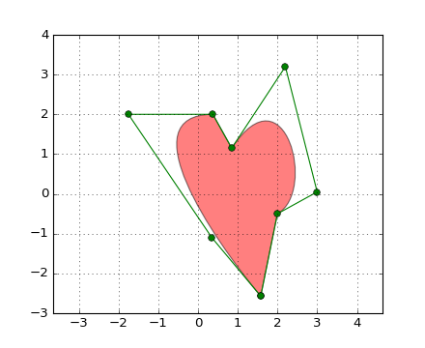
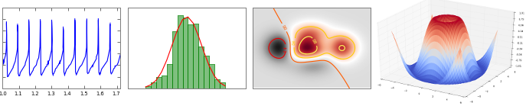
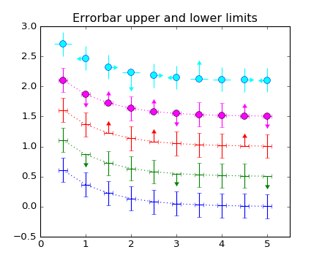

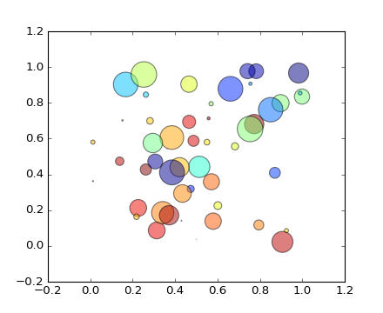
Plotting
“A plot is worth a thousand words"

Slide 12
matplotlib is a python 2D plotting library which produces publication quality figures in a variety of hardcopy formats and interactive.
You can generate plots, histograms, power spectra, bar charts, errorcharts, scatterplots, etc, with just a few lines of code.
Check this out:
http://matplotlib.org/gallery.html

Slide 13
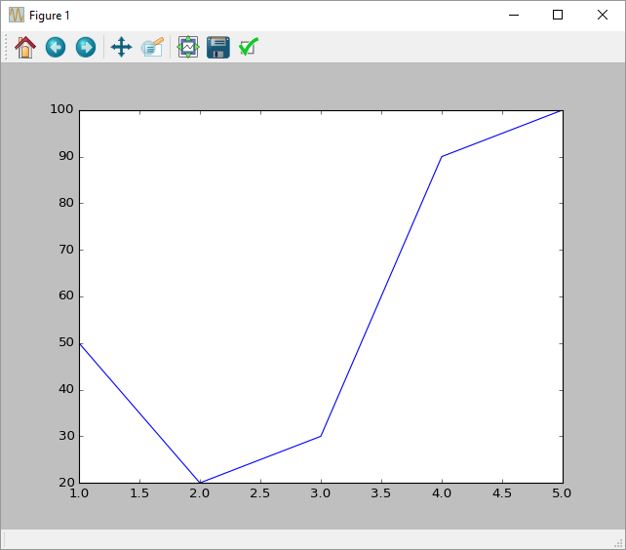
Example 1
import numpy as np
import matplotlib.pyplot as plt
x = np.array([1, 2, 3, 4, 5])
y = np.array([50, 20, 30, 90, 100])
plt.plot (x,y)
plt.show()

Slide 14
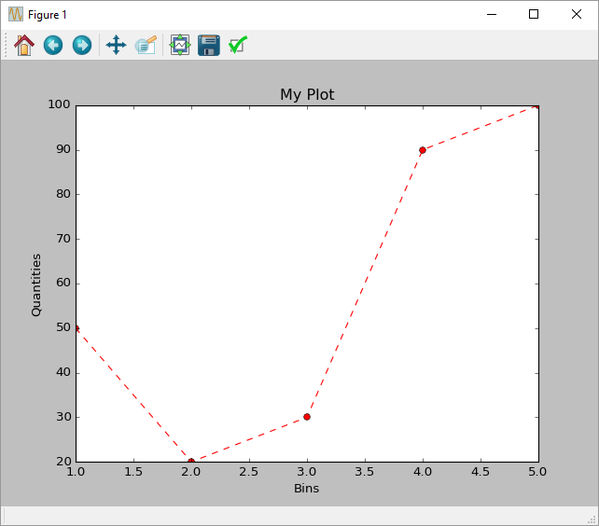
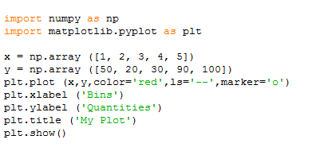
Example 1b

Slide 15
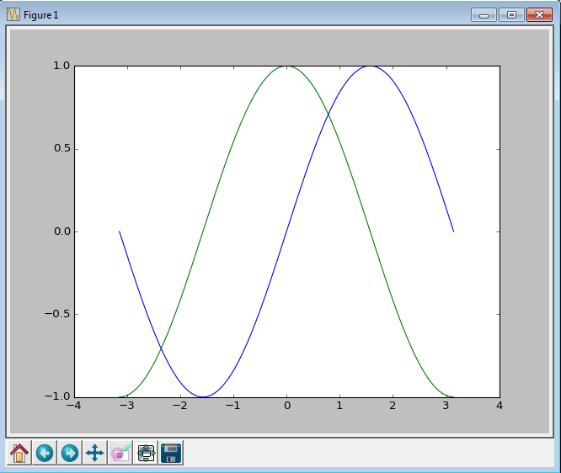
Example 2
import matplotlib.pyplot as plt
import numpy as np
x = np.linspace(-np.pi, np.pi)
y, z = np.cos(x), np.sin(x)
plt.plot(x, y, color = 'green')
plt.plot(x, z, color = 'blue')
plt.show()

Slide 16
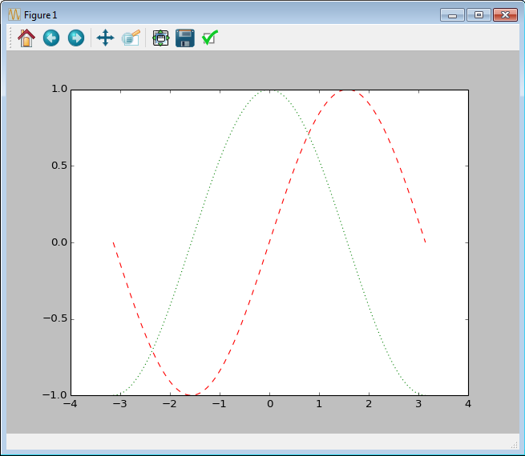
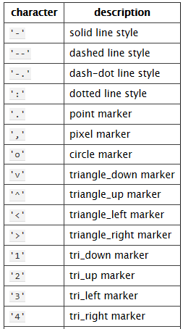
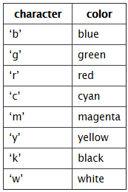
Example 2b
x = np.linspace(-np.pi, np.pi)
y, z = np.cos(x), np.sin(x)
plt.plot(x, y, color = 'green')
plt.plot(x, z, ‘r--')
plt.show()

Slide 17
Binary search exercise

Slide 18
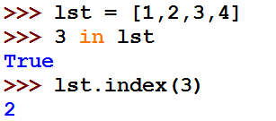
Search
What happens when we execute:
?
We somehow search the list to see if the element “3” an element of the list.
How can the search algorithm be implemented?
18

Slide 19

Naïve search in a general list
Find index of a value in a given list
def sequential_search(value, lst):
for i in range(len(lst)):
if lst[i] == value:
return i
return None
print sequential_search('a', ['b', 'a'])
1

Slide 20
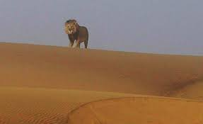
Binary Search (requires a sorted list)
Input Sorted list lst, query value
Output Corresponding index / not found
Algorithm:
Check the middle value of lst
If middle == value, return the middle index
If value < middle search in lower half of lst
If value > middle search in higher half of lst

Slide 21
Example
Searching for 56
index
0
1
2
3
4
5
6
7
8
9
value
-5 | -3 | 0 | 4 | 8 | 11 | 22 | 56 | 57 | 97

Slide 22
Example
Searching for 4
index
0
1
2
3
4
5
6
7
8
9
value
-5 | -3 | 0 | 4 | 8 | 11 | 22 | 56 | 57 | 97

Slide 23
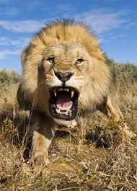
Code – Binary Search
def binary_search_rec(value, lst, start, stop): if start >= stop: return None middle = (stop + start) / 2 if lst[middle] == value: # item found return middle elif value < lst[middle]: # item cannot be in top half return binary_search_rec(value, lst, start, middle) else: # item cannot be in bottom half return binary_search_rec(value, lst, middle + 1, stop)
>>> binary_search_rec(5, [1,4,5,8], 0, 4)
2

Slide 24
Execution example – searching for 56
0
1
2
3
4
5
6
7
8
9
-5 | -3 | 0 | 4 | 8 | 11 | 22 | 56 | 57 | 97
start
middle
stop
middle | stop | start
(0+10)/2 = 5 | len(lst) = 10 | 0

Slide 25
Execution example – searching for 56
middle
0
1
2
3
4
5
6
7
8
9
-5 | -3 | 0 | 4 | 8 | 11 | 22 | 56 | 57 | 97
start
stop
middle | stop | start
(0+10)/2 = 5 | len(lst) = 10 | 0
(6+10)/2 = 8 | 10 | 6
(6+8)/2=7 | 8 | 6

Slide 26
Execution example – searching for 4
0
1
2
3
4
5
6
7
8
9
-5 | -3 | 0 | 4 | 8 | 11 | 22 | 56 | 57 | 97
start
middle
stop
middle | stop | start
(0+10)/2 = 5 | len(lst) = 10 | 0

Slide 27
Execution example – searching for 4
0
1
2
3
4
5
6
7
8
9
-5 | -3 | 0 | 4 | 8 | 11 | 22 | 56 | 57 | 97
start
middle
stop
middle | stop | start
(0+10)/2 = 5 | len(lst) = 10 | 0
(0+5)/2=2 | 5 | 0

Slide 28
Execution example – searching for 4
0
1
2
3
4
5
6
7
8
9
-5 | -3 | 0 | 4 | 8 | 11 | 22 | 56 | 57 | 97
start
middle
stop
middle | stop | start
(0+10)/2 = 5 | len(lst) = 10 | 0
(0+5)/2=2 | 5 | 0
(3+8)/2=4 | 5 | 2+1=3

Slide 29
Execution example – searching for 4
middle
0
1
2
3
4
5
6
7
8
9
-5 | -3 | 0 | 4 | 8 | 11 | 22 | 56 | 57 | 97
start
stop
middle | stop | start
(0+10)/2 = 5 | len(lst) = 10 | 0
(0+5)/2=2 | 5 | 0
(3+8)/2=4 | 5 | 2+1=3
3 | 4 | 3

Slide 30
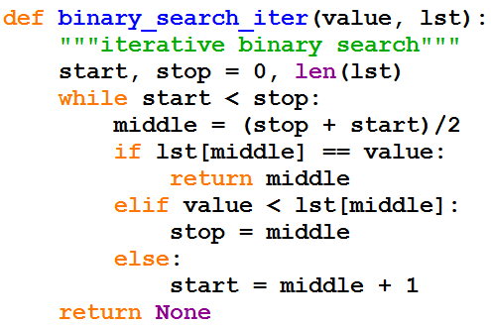
Iterative Implementation

Slide 31
Summary

Slide 32
Syllabus
Python programming basics
Variables and Memory
Loops
List, Tuples, Dictionaries
Functions
File Input/Output
Error handling
Recursions, Memoization,
Object-Oriented Programming
Scientific calculations using Numpy
Data analysis using pandas
Image processing
32
Notes:
32

Slide 33
ABOUT THE EXAM
Three Hours
Writing code on paper
One double sided A4 formula sheet is allowed.

Slide 34
How to study?
Review the presentations (both lectures and recitations)
Make sure you understand the explanations and code
Summarize important things such as syntax and methods (things that will be useful in the cheat sheet).
Review the home exercises
Solve as many exams as you can on paper, going backward in time.

Slide 35

Welcome to Programming for Engineers course!
We will learn to program in Python.
Goal: enable you to use programming as a tool to solve “real world” problems.
Hard work is required!
35
Notes:
35

Slide 36
Course Objectives
Develop basic programming and algorithmic skills
36
Notes:
36

Slide 37
Syllabus
Python programming basics
Recursion
Sort & Search algorithms
Object-Oriented Programming
Image Processing
Scientific Calculations
Simulations
Data analysis
Error Handling
37
Notes:
37

Slide 38
Our Motivation
What computational capabilities do engineers need?
Ability to write simple scripts
Ability to use existing tools (modules)
Problems solving capabilities
Understand what and how CS people do
For better collaboration
General knowledge
38

Slide 39
Good Luck and Thank you!
39

